Slide 1
ESOPHAGITIS by Assist. Prof Hussein Al Naji

Slide 2
ESOPHAGITIS
Inflammation of the esophagus is accompanied initially by clinical findings of spasm and obstruction, pain on swallowing and palpation, and regurgitation of bloodstained slimy material.
ETIOLOGY
Primary esophagitis caused by
The ingestion of chemical or physical irritants is usually accompanied by stomatitis and pharyngitis.
Laceration of the mucosa by a foreign body or complications of nasogastric intubation can occur.

Slide 3
3. Nasogastric intubation is associated with a higher risk of pharyngeal and esophageal injury when performed in horses examined for colic.
4. Death of Hypoderma lineatum larvae in the submucosa of the esophagus of cattle can cause acute local inflammation and subsequent gangrene.
5. Inflammation of the esophagus occurs commonly in many specific diseases, particularly those that cause stomatitis, but the other clinical signs of these diseases dominate those of esophagitis.

Slide 4
PATHOGENESIS
Inflammation of the esophagus combined with local edema and swelling results in a functional obstruction and difficulty in swallowing.
CLINICAL FINDINGS
In the acute esophagitis.
There is salivation and attempts to swallow, which cause severe pain, particularly in horses.
In some cases, attempts at swallowing are followed by regurgitation and coughing, pain, retching activities, and vigorous contractions of the cervical and abdominal muscles.

Slide 5
3- In specific diseases such as mucosal disease and bovine malignant catarrh, there are no obvious clinical findings of esophagitis, because the lesions are mainly erosive.
4- Endoscopy of the esophagus will usually reveal the location and severity of the lesion.
CLINICAL PATHOLOGY
In severe esophagitis of traumatic origin a marked neutrophilia can occur, suggesting active inflammation.

Slide 6
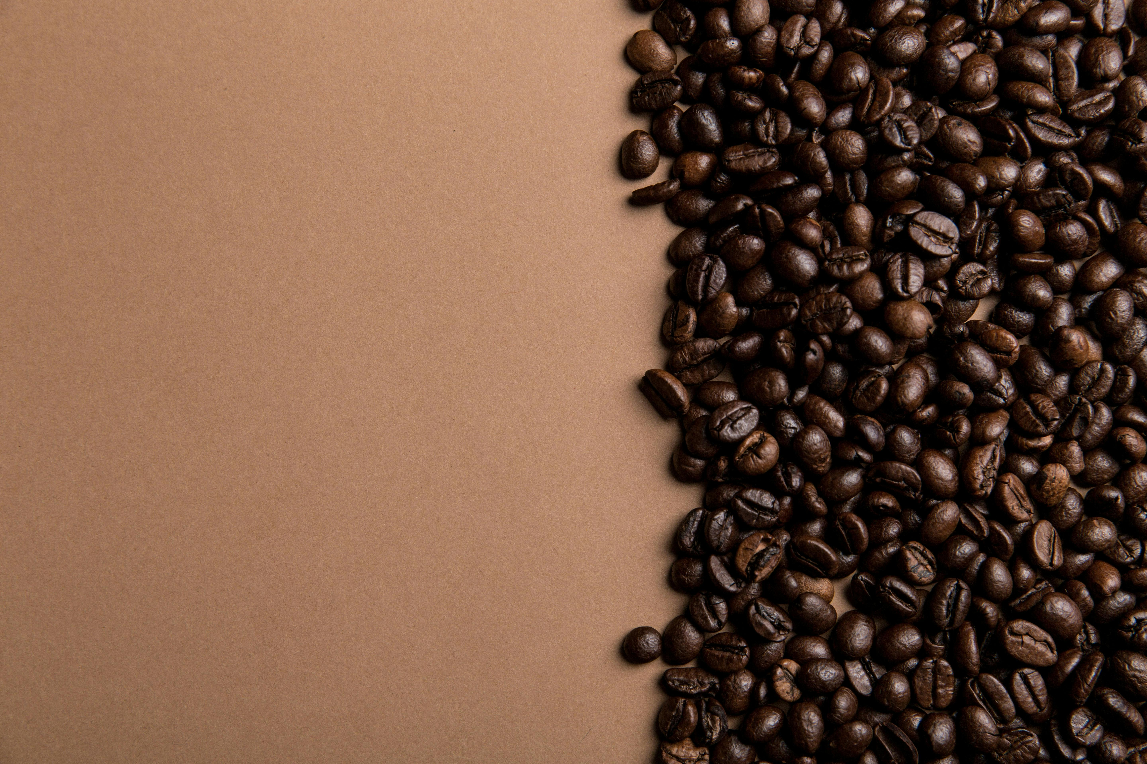
NECROPSY FINDINGS
Pathologic findings are restricted to those pertaining to the various specific diseases in which esophagitis occur.
DIFFERENTIAL DIAGNOSIS
Esophagitis must be differentiated from pharyngitis, in which attempted swallowing is not as marked and coughing is more likely to occur. Palpation can also help to localize the lesion; however, pharyngitis and esophagitis usually occur together

Slide 7
TREATMENT
Feed should be withheld for 2 to 3 days and fluid and electrolyte therapy can be necessary for several days.
Parenteral antimicrobials are indicated, especially if laceration or perforation has occurred.
Reintroduction to feed should be monitored carefully and all feed should be moistened to avoid the possible accumulation of dry feed in the esophagus, which might not be fully functional.

Slide 8
Thank you

